Slide 1
Course overview
Recap

Slide 2
Python Advanced
Which components have we seen that are relevant for NLP and in which manner are they relevant?

Slide 3
Python Advanced
Which components have we seen that are relevant for NLP and in which manner are they relevant?
Regex:
File-handling:
Scraping:
Threading:

Slide 4
Python Advanced
Which components have we seen that are relevant for NLP and in which manner are they relevant?
Regex: extract, substitute and do variety of other string manipulation on patterns in text
File-handling: we will need to load data within Python and store the results
Scraping: automatically retrieve the data you need in large batches
Threading: Analyse multiple batches at the same time

Slide 5
Pre-processing
Which pre-processing steps have we seen and why are they important?

Slide 6
Pre-processing
Which pre-processing steps have we seen and why are they important?
Tokenization:
Lemmatization:
Remove stop words
Html tags:
Tagging:
chunking:

Slide 7
Pre-processing
Which pre-processing steps have we seen and why are they important?
Tokenization: split in words
Lemmatization: bring words back to root
Remove stop words
Html tags: give extra information to text in order to improve performance
Tagging: give extra information to text in order to improve performance
chunking: improve vocabulary

Slide 8
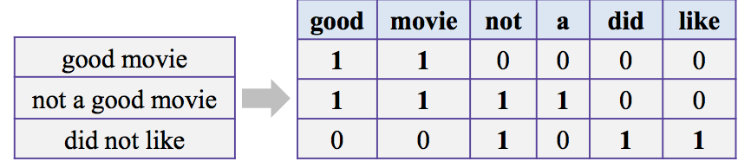
Transform text to vectors
Bag of Words
https://gdcoder.com/nlp-transforming-tokens-into-features-tf-idf/

Slide 9
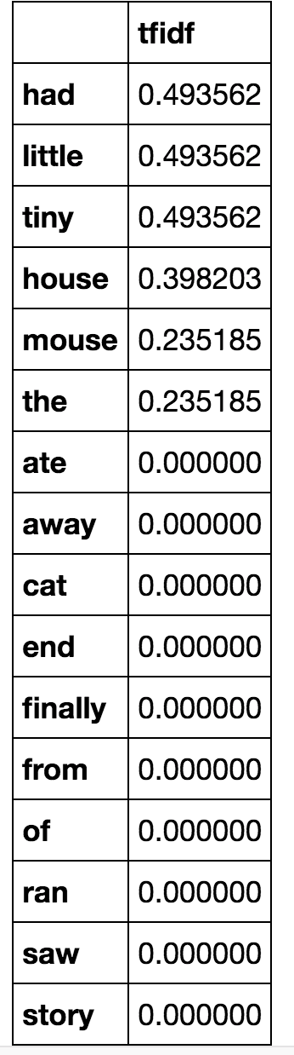
Transform text to vectors
tf-idf
Bag of Words
https://gdcoder.com/nlp-transforming-tokens-into-features-tf-idf/
https://kavita-ganesan.com/tfidftransformer-tfidfvectorizer-usage-differences/#.YGLE52Qzb0o

Slide 10
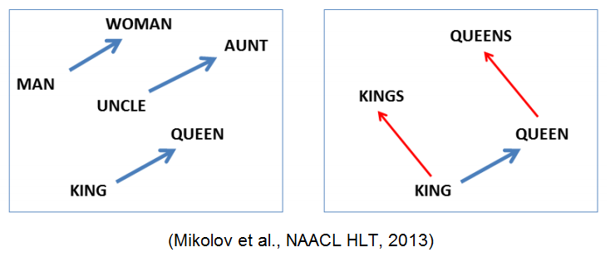
Transform text to vectors
tf-idf
Bag of Words
https://gdcoder.com/nlp-transforming-tokens-into-features-tf-idf/
https://kavita-ganesan.com/tfidftransformer-tfidfvectorizer-usage-differences/#.YGLE52Qzb0o
Word2vec (without context)

Slide 11
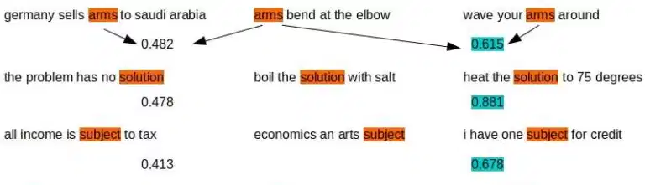
Transform text to vectors
tf-idf
Bag of Words
https://gdcoder.com/nlp-transforming-tokens-into-features-tf-idf/
https://kavita-ganesan.com/tfidftransformer-tfidfvectorizer-usage-differences/#.YGLE52Qzb0o
Bert
Word2vec (without context)
https://xplordat.com/2019/09/23/bow-to-bert/

Slide 12
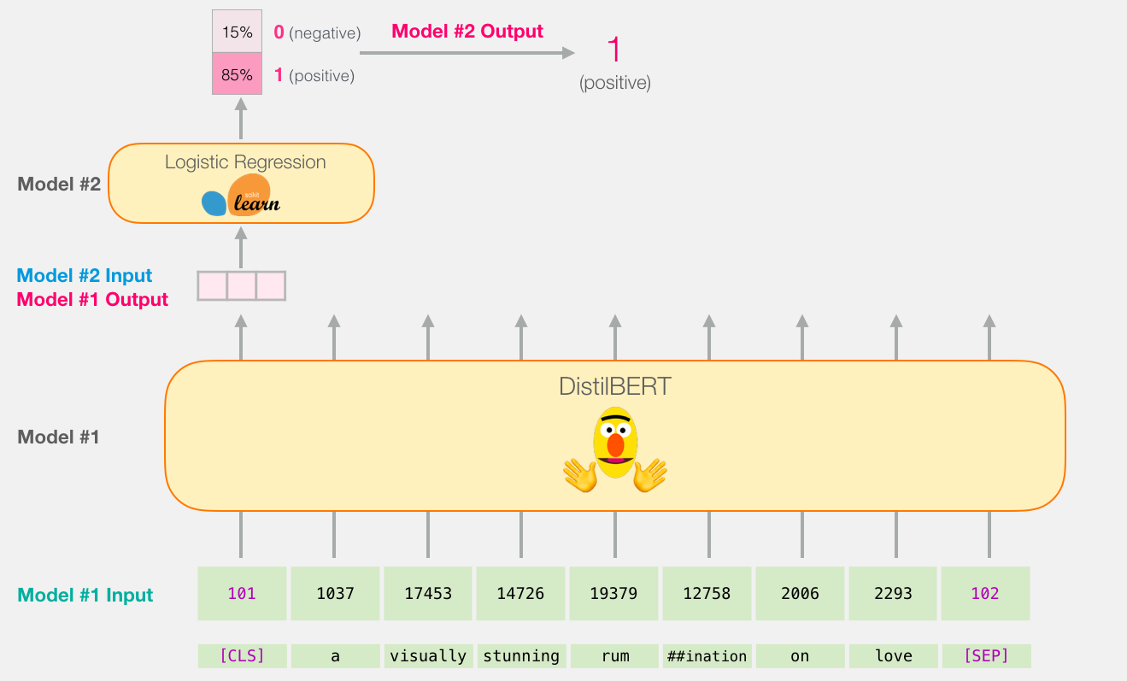
Use the vector to make predictions
https://jalammar.github.io/a-visual-guide-to-using-bert-for-the-first-time/

Slide 13
Use the vector to make predictions

